Slide 1
Tale of two sections in gut – Distribution of gut microbiota across foregut and cecum
Arpan Kumar Basak
Evolutionary Physiology Team
Institute of Environmental Sciences,
Jagiellonian University

Slide 2


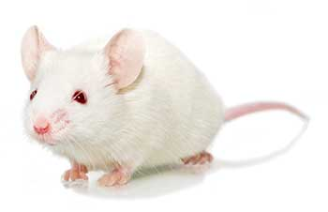
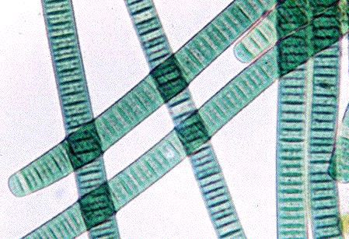
Visweswaraya Technological University
Graduation in Engineering - Biotechnology

Slide 3

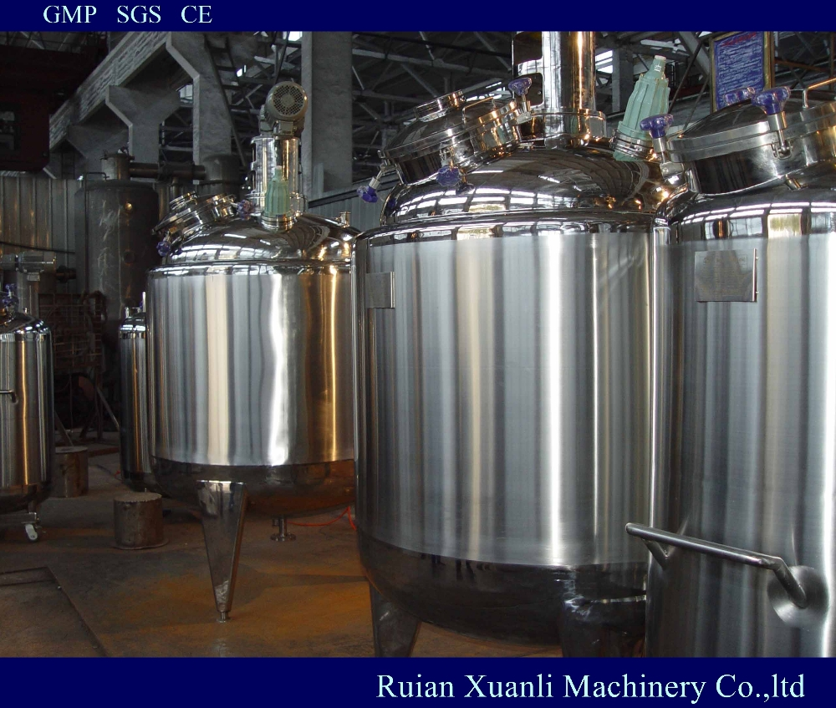
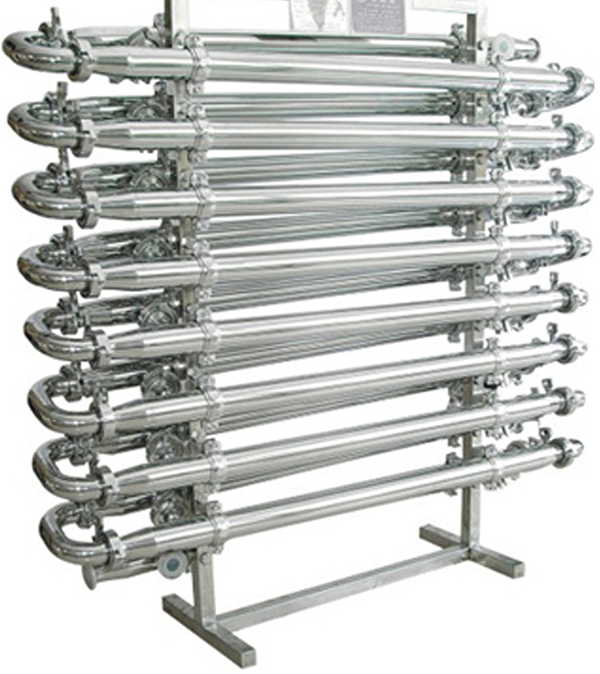
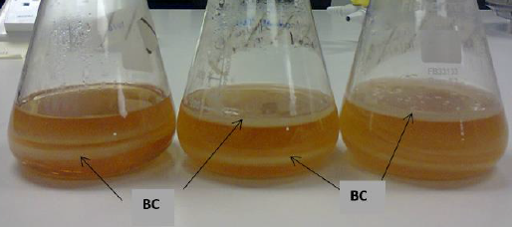
National Institute of Technology
Masters in Engineering - Biotechnology

Slide 4

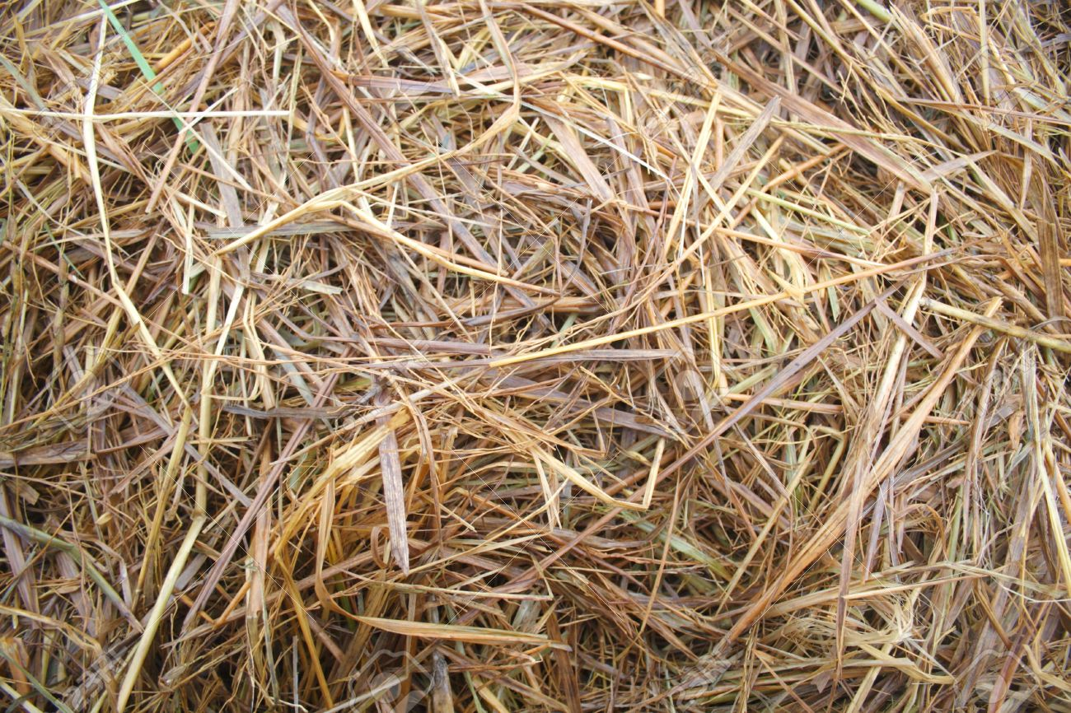
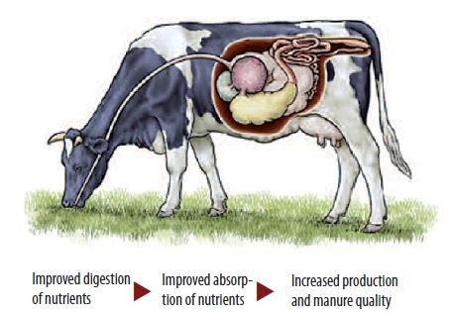
Central Mechanical Engineering Research Institute
Intern in Thermal Engineering – Delignification strategies for complex biomass

Slide 5
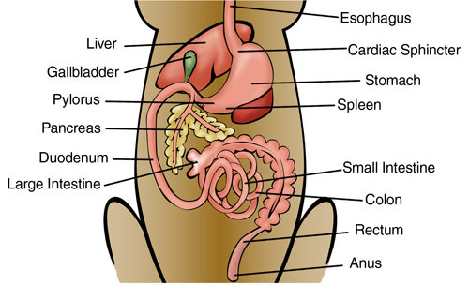
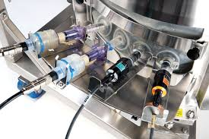
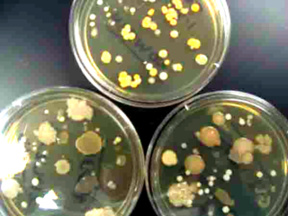
Gut as a bio-reactor

Slide 6


Slide 7
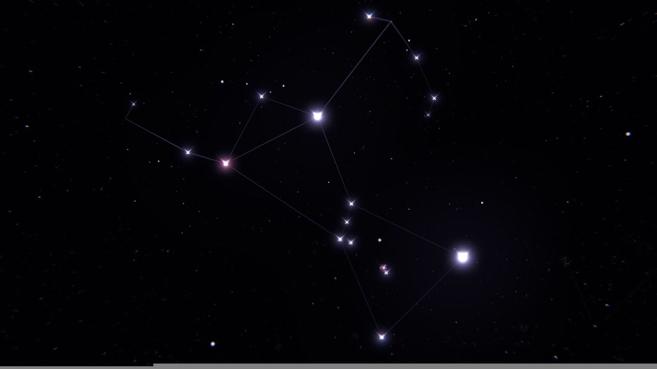

Slide 8
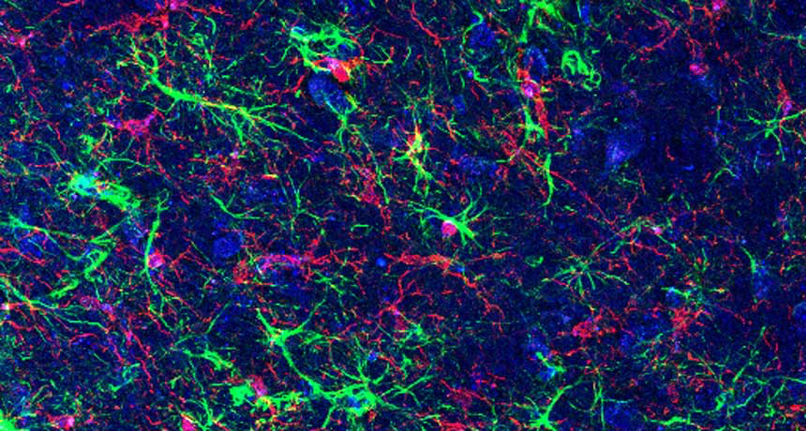

Slide 9
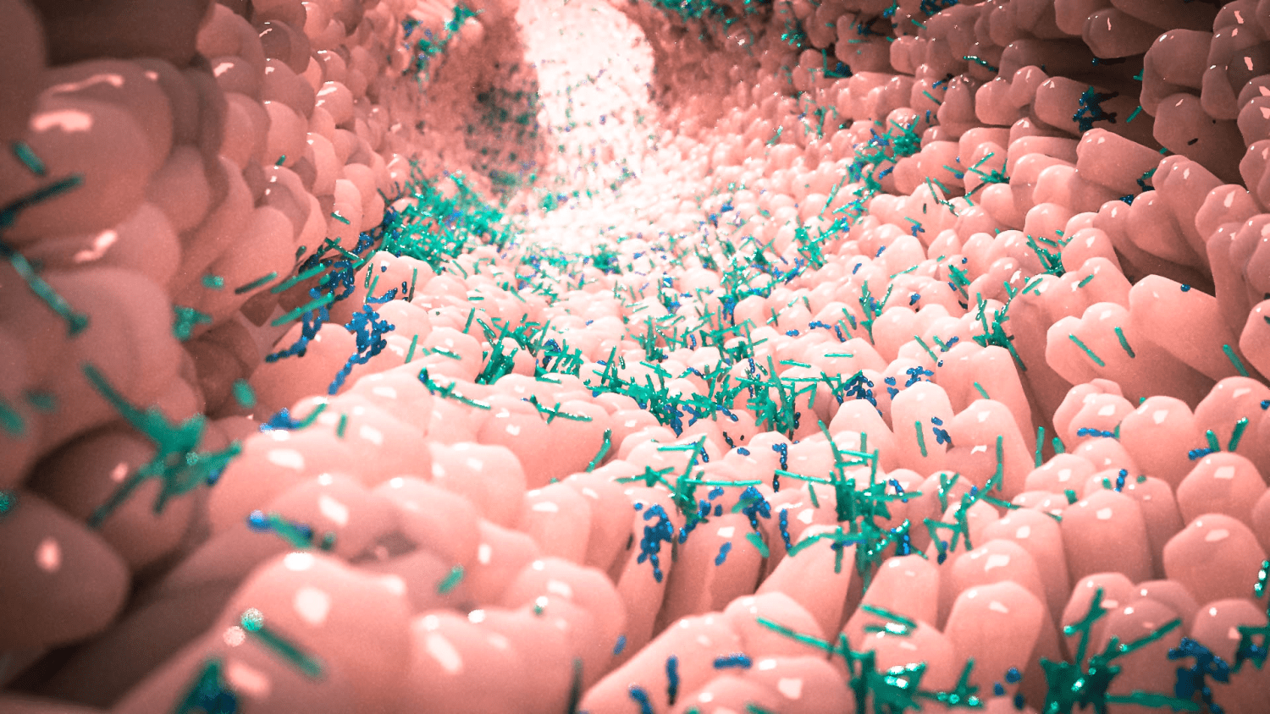

Slide 10
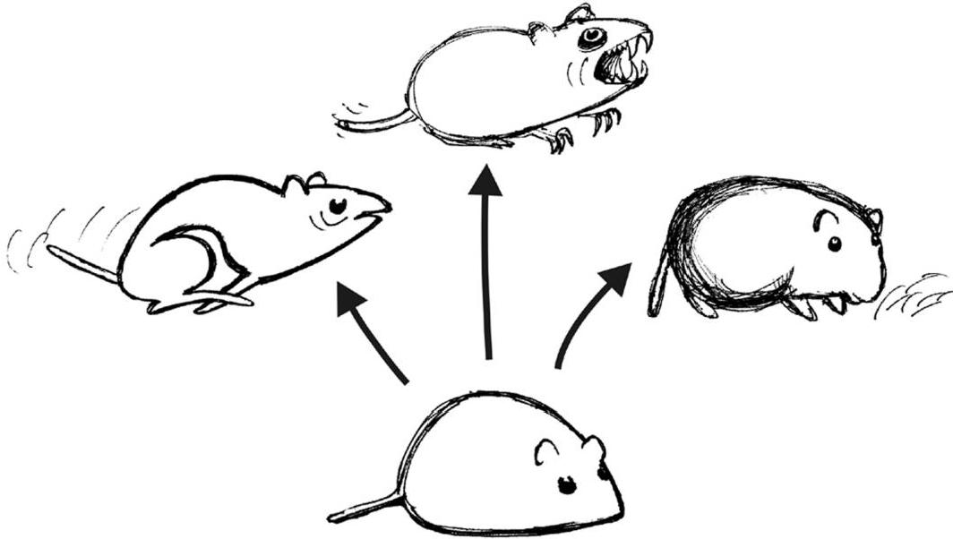
Adaptive Radiation model
P
A
H
C

Slide 11
Background
How does Herbivores digest complex fibre?
What complex mechanism makes them develop the ability of enhanced digestibility?
Do they have relatively more abundant fibre digesting gut –microbiota?
How is this symbiotic relation maintained – from the point of host-microbe interaction?

Slide 12
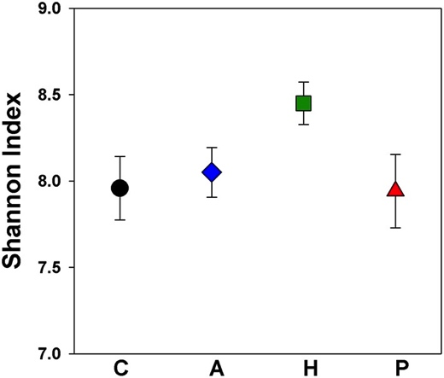
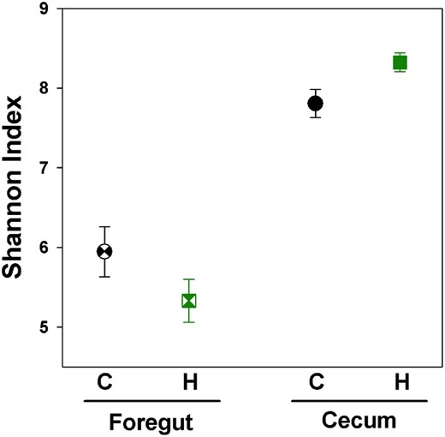
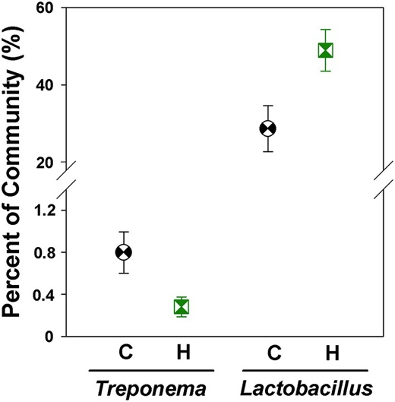
Previous studies
H lines are born fibre digesters
Cecum is a natural fermentation tank
Lactobacillus populates the H-Line gut

Slide 13
Objectives
Community structure of microbes in gut sections
Diversity within bacterial community
Mean relative abundance of gut-microbes across gut-sections
Obtain significant microbial genus on gut-sections

Slide 14
Predictions
There will be less differences in microbial community within sections
Dramatic differences between sections foregut and cecum
Fiber digesting bacterial genus will be more in cecum

Slide 15
Methods in Microbial culture
Classical
Microbial Plating
Microscopy and staining techniques
Shot-gun sequencing
Next Generation Sequencing
Genetic marker followed by sequencing

Slide 16
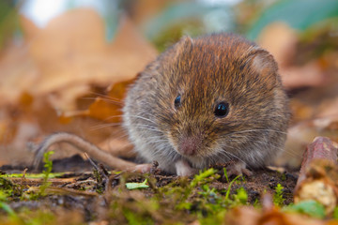
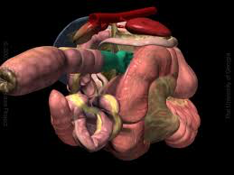
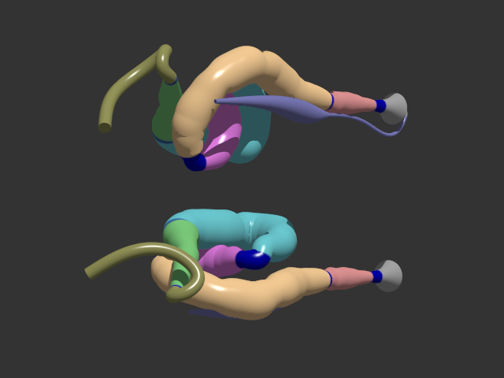
16 Animals
Foregut
Cecum
2 Sub-sections
3 Sub-sections

Slide 17
Methodology
Sample Collection
16s Ribosomal RNA Sequencing
DC – Distal Cecum
DF – Distal Foregut
MC – Mid Cecum
PC – Proximal Cecum
PF – Proximal Foregut
Foregut
Cecum
PF
DF
PC
MC
DC

Slide 18
Community structure
Bray Curtis and Weighted UniFrac Distances
NMDS (Non-metric Multi-Dimensional Scaling)

Slide 19
Community structure

Slide 20
Diversity within sections
Pairwise wilcoxon test
Within foregut – Not Significant (p > 0.05)
Within Cecum – Not Significant (p > 0.05)
Between Foregut and Cecum – Significant (p < 0.05)

Slide 22
Abundance of microbes
Mean relative abundance compared across sections of gut
Kruskal Wallis Test
Distribution was not normal

Slide 23
DC – Distal Cecum
DF – Distal Foregut
MC – Mid Cecum
PC – Proximal Cecum
PF – Proximal Foregut

Slide 27
Heatmap

Slide 31
Further research
How bacterial community in the gut shapes a physiological trait in a complex organism?
Enhanced digestibility in herbivore
Gut-microbes ~ Liver + Brain + Pancreas + Immunity + …
How the host-organism selectively cultures efficient microbes in gut?
Is it genetic or environmental influx?
How the concept of HOLOBIONT (host-microbe interaction) significantly develop the trait of “Herbivore”

Slide 32
Conclusion
Micro-organisms are dispersed across our gut
Environment of specific region of host organism shape specific microbial community
Specific microbes play important role in fiber digestion.

Slide 33
Thank you for your attention!
Find the presentation and documents on
https://github.com/arpankbasak/ZFE_UJ

